Slide 1


Technical Presentation
CO-1
Assesment Tool - 3
ITA – 0515 COMPUTER VISION
Presented By :
S Durga Prasad (192472091)
G Manoj (192312234)
Tharun Sai Gangadhar P (192521486)
Purushothaman N ( 192421313)
Jagan R(192321102)
Guided By:
Dr. M.J Carmel Mary Belinda

Slide 2
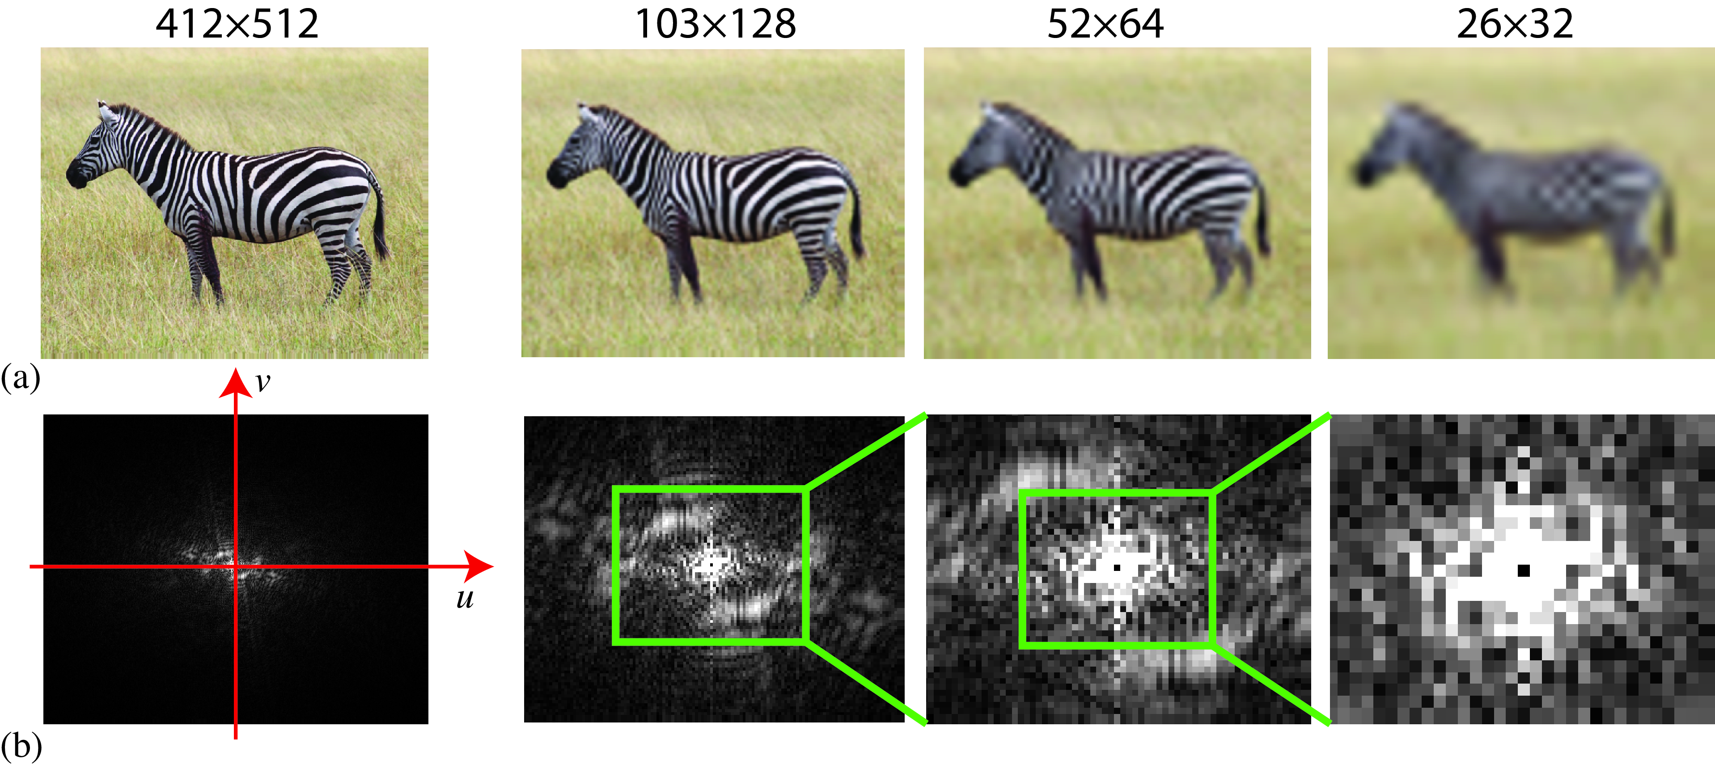
Introduction to Sampling and Resolution
Sampling
Converts a continuous image into discrete pixels.
Determines the amount of spatial information captured.
Influences image quality during digitization.
Forms the basis of digital image processing.
Resolution
Represents the total number of pixels in an image.
Expressed as Width × Height (e.g., 1920 × 1080).
Higher resolution captures finer details.
Improves image clarity and visual perception.

Slide 3
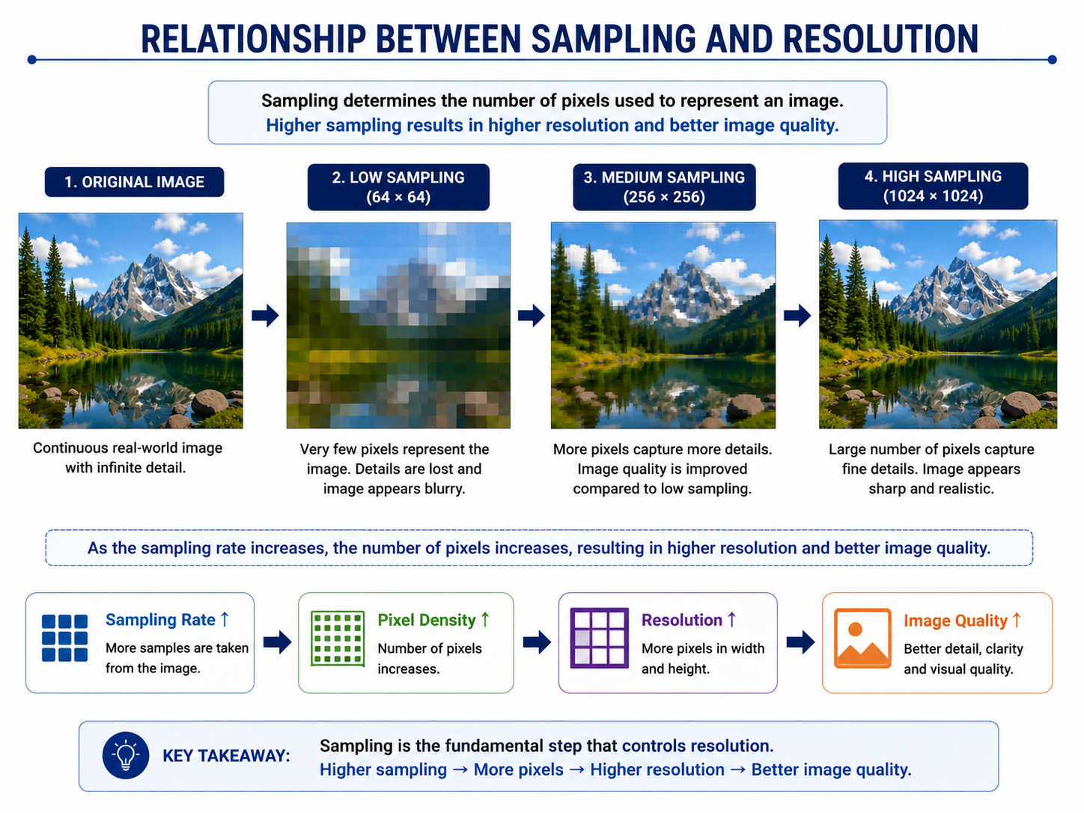
Relationship Between Sampling and Resolution
Sampling determines the number of pixels representing an image.
Higher sampling density results in higher image resolution.
Increased resolution preserves more image details.
Better resolution improves feature extraction and analysis.
Proper sampling ensures accurate digital representation.

Slide 4
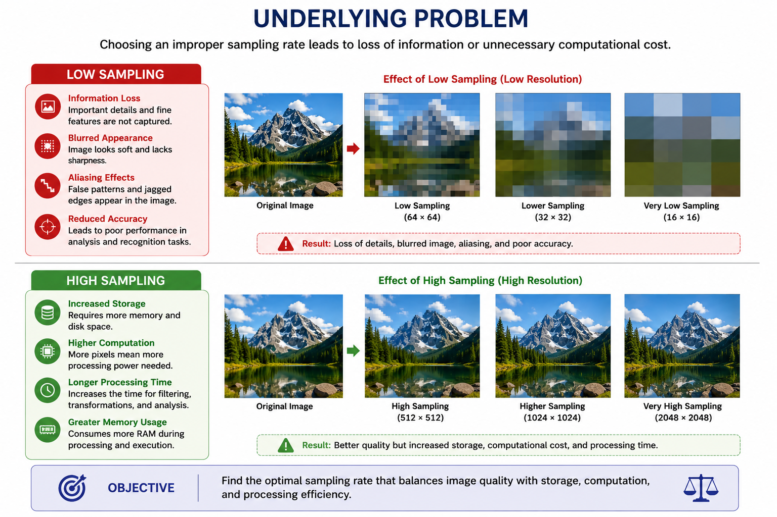
Underlying Problem
Low sampling causes information loss and blurred images.
Insufficient sampling introduces aliasing and distortion.
Excessive sampling increases storage and memory requirements.
Higher sampling also increases computational complexity.
Selecting an optimal sampling rate is essential for efficient image processing.

Slide 5
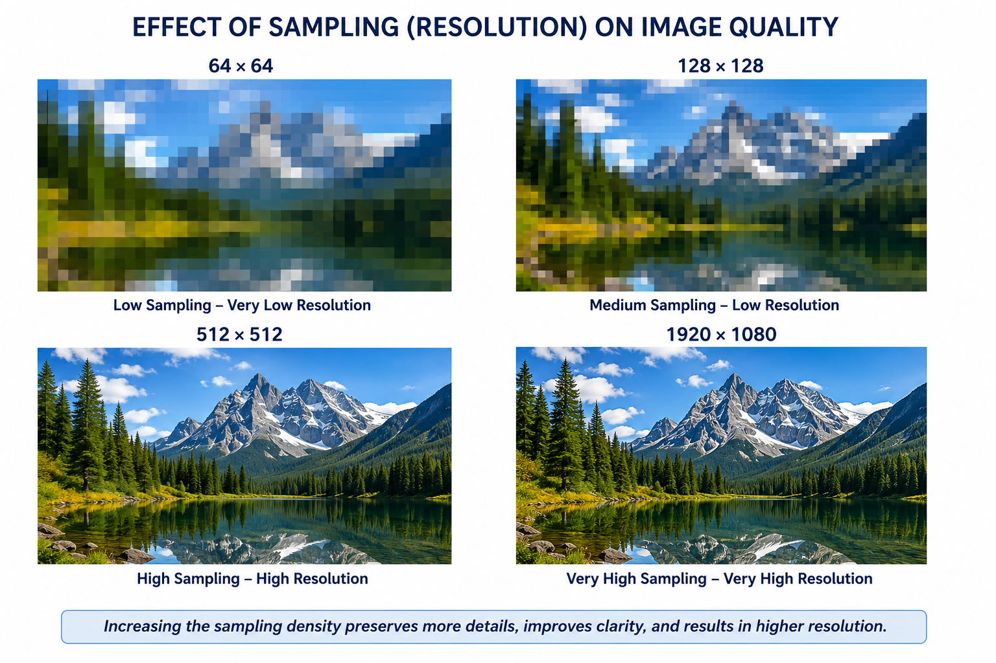

Slide 6
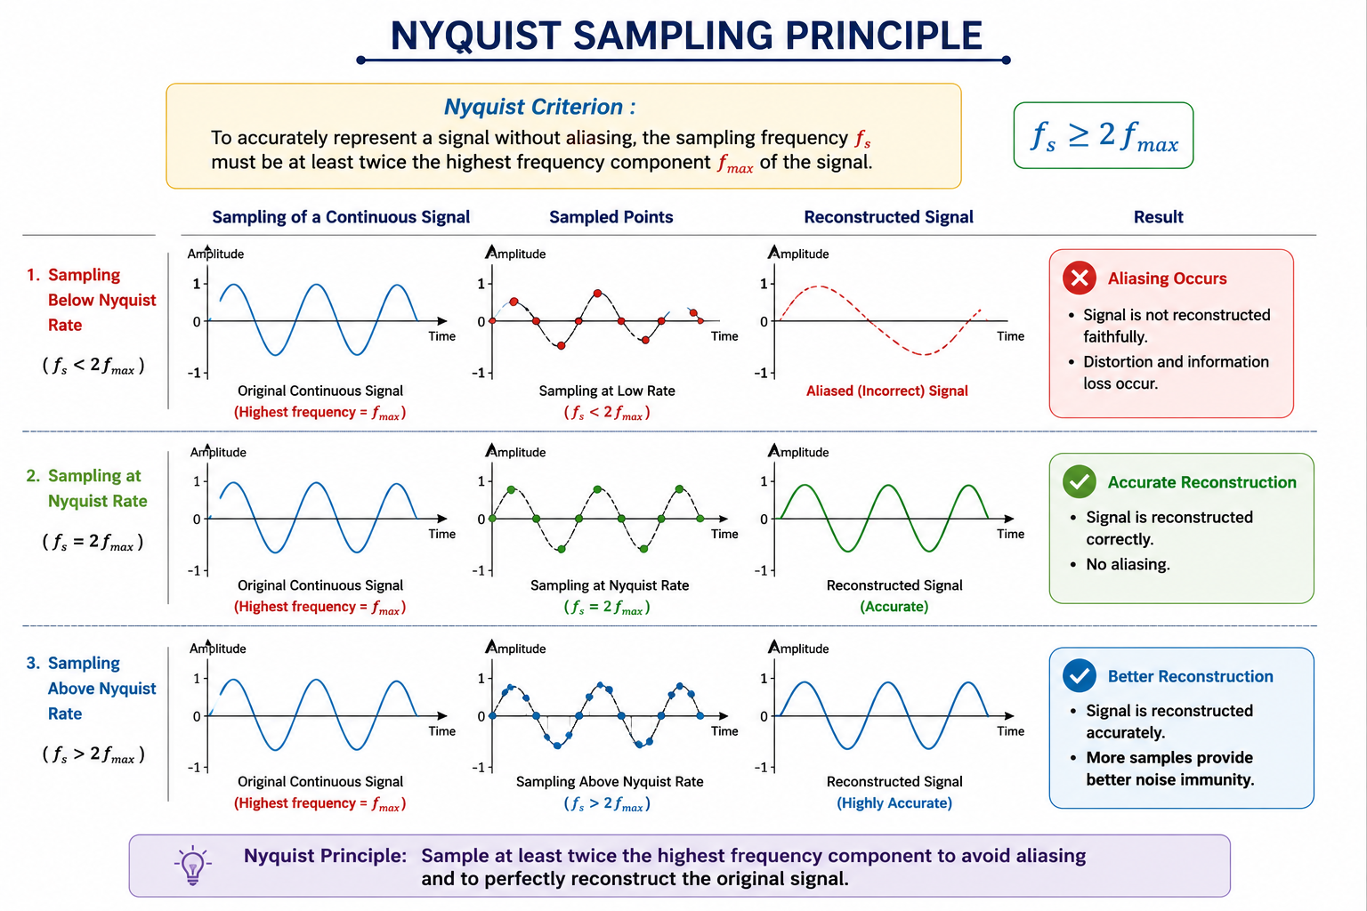
Nyquist Sampling Principle
Nyquist theorem defines the minimum required sampling rate.
Sampling frequency should be at least twice the highest image frequency.
Proper sampling prevents aliasing artifacts. Ensures accurate reconstruction of the original image.
Widely applied in digital imaging and signal processing.

Slide 7
Analytical Comparison
Low Sampling | High Sampling
Low Resolution | High Resolution
Loss of Details | Better Detail Preservation
Smaller File Size | Larger File Size
Faster Processing | Higher Processing Time
Lower Accuracy | Higher Accuracy

Slide 8
Conclusion
Sampling converts continuous images into digital pixel representations.
Resolution directly depends on the sampling density. Proper sampling minimizes aliasing and information loss.
Higher resolution improves image interpretation and analysis.
Optimal sampling balances image quality, storage, and computational efficiency.

